Slide 1

C3 COGNITIVE ASPECTS

Slide 2
Overview
What is cognition and why it is important for ID?
What attention is and its effects on our ability to multitask.
Describe how memory can be enhanced through technology aids.
Explain what mental models are.
Different between classic internal cognitive frameworks and more recent external cognitive approaches.
Elicit mental models

Slide 3
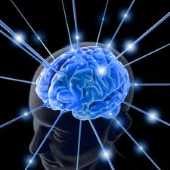
Introduction
Understand what humans are good and bat at
  人機互動是認知過程，需瞭解認知過程與限制 Interacting with technology is cognitiveWe need to take into account cognitive processes involved and cognitive limitations of users.
How this knowledge can be used to inform the design of technologies
Look at some cognitive-based conceptual frameworks

Slide 4
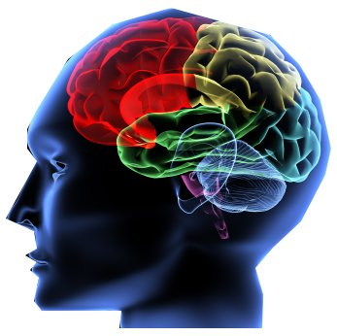
3.2 What is cognition?
每日腦部進行哪些活動?
  Different kinds of cognition: 思考，記憶，學習，決策，觀察，寫作，說話 thinking, remembering, learning, daydreaming, decision-making, seeing, reading, writing, talking.
Norman - two modes:
  Experiential cognition 體驗式認知 : We perceive, act, and react to events around us effectively and effortlessly. 我們與週遭事件互動的一種心理狀態，不需過於費力 (開車，閱讀，電玩)
  Reflective cognition 反思式認知 : lead to new ideas and creativity. It involves thinking, comparing, and decision-making 需要進行思考，比較、創作… 等心智活動，如設計、學習、寫作…
    以上兩種cognition, each requires different kinds of technological support

Slide 5
Cognition can be distributed, situated, extended, and embodied. It depends on --
  Context in which it takes place
  The tools that are employed
  The artifacts and interfaces that are used
  The people involved

Slide 6
Attention
在特定範圍與時間內對事物選擇性的專注 Selecting things to concentrate on from the mass around us, at a point in time
Involves our auditory and/or visual senses
It allows us to focus on information that is relevant to what we are doing.
難易度取決於 process easy or difficult depends on:
  Whether we have clear goals (order a meal match available information)
  Whether the information we need is salient in the environment (poorly structured information is difficult to find)

Slide 7
Design implications for attention
Make information salient when it needs attending to
Use techniques that make things stand out like colour, ordering, spacing, underlining, sequencing and animation
Avoid cluttering the interface - follow the google.com example of crisp, simple design
Avoid using too much because the software allows it
Search engines and form fill-ins are simple and easier to use

Slide 8
Multitasking and attention
While focusing on one task at a screen, we switch constantly between others.
Research findings of multitasking on memory and attention ---
  Depends on the nature of the tasks and attention it demands Individual differences
    Heavy multitaskers are likely to be those who are easily distracted and find it difficult to filter out irrelevant information.
      EX. Chiaying, Chinfan

Slide 9
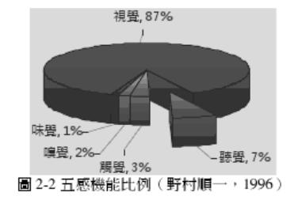
知覺 Perception
How information is acquired from the environment, via the different sense organs (感官) and transformed into experiences of objects, events, sounds, and tastes 環境中的訊息被五官感知並轉化成與物體事件聲音…等有關的經驗.
Vision最為主要、hearing 次之，之後是touch
研究報告：人的大腦每天通過五種感官接受外部信息，
提供訊息的媒介最好能夠運用同時呈現圖片、聲音、動態影像的多媒體來進行，才能獲得最佳的認知效果。

Slide 10
以適當形式呈現資訊以輔助知覺與辨識 Information needs to be represented in an appropriate form to facilitate the perception and recognition of its meaning.
Obvious implication is to design representations that are readily perceivable, e.g.
  Text should be legible
  Icons should be easy to distinguish and read

Slide 11
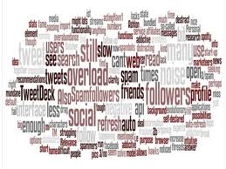
Memory
Involves recalling various kinds of knowledge that allow us to act appropriately.
Involves encoding and recalling knowledge and acting appropriately
We don’t remember everything - involves filtering and processing

Slide 12
Filtering process:
  Encoding determines which information is attended to and how it is interpreted. 決定哪些訊息將被注意、如何解讀，encode程度愈高，越易被回想起 (學習時利用reflection, exercise, discussion, write notes…)
  “Context in which it is encoded” is important in affecting our memory

Slide 13
People are much better at recognizing things than recalling things
  The rise of the GUI over command-based interfaces
Certain kinds of information are easier to recognize than others
  better at remembering images than words-- The use of icons rather than names
利用記憶法(mnemonic)加強記憶

Slide 14
Memory and search
File management and retrieval is a real problem to most users
Research on information retrieval can be usefully applied
  Lansdale: Memory involves 2 processes
    recall-directed and recognition-based scanning 先利用記得的訊息來縮小可能性，若無法記得則採用scan (如搜尋bookmark)
File management systems should be designed to optimize both kinds of memory processes
  System let people use their memory to limit the search area
  Then represent the information in this area to maximally assist them in finding infomration

Slide 15
Memory load and passwords
Phone banking -- how to manage security concerns?
Use external representation at hand --- write down their detailed on a sheet of paper

Slide 16
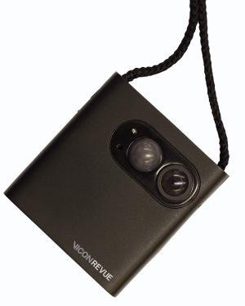
Computing aids for memory loss
Use technologies to help memory impaired people
1. Prototype system – Cook’s Collage
  Provide memory support for cooking tasks
  Display a series of images
2. SenseCam
  小型可攜式的數位照相機，可定時(30秒)自動拍攝，或是感應到場景有變化的時候才自動拍攝。所以這個東西不是拍好看的，而是用來「助記」，可以幫助人們紀錄日常生活。根據研究團隊的實驗發現，一名原本只能記得當週發生事件約 2% 的婦女，藉由 SenseCam 的協助之後，她只需要每兩天花上一個小時的時間複習影片，就能夠回想起 80% 的重要事件。

Slide 17
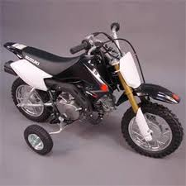
3.2.4 Learning
與使用系統有關的兩種情況
How to use a computer-based application
Using a computer-based application to understand a given topic
人們難以依循手冊的步驟來學習
They prefer to “learn through doing” ，GUI提供直接弄方式能輔助探索式的人機互動，並提供undo功能
Training wheel – 依據生手程度限制部分功能，之後再擴充功能

Slide 18
Benefits of interactive technologies:
  Provide alternative ways of representing and interacting with information not possible with traditional technologies (book, video)
  e.g. Virtual reality, interactive media wall
Interactive media wall allows you to list through photographs, zoom in and out, scroll documents.

Slide 19
3.2.5 Reading, speaking and listening
Three forms of language processing
  「閱讀」比「說」、 「聽」來的迅速 Reading can be quicker than speaking or listening.
  「聽」花費較少的認知處理過程 Listening requires less cognitive effort than reading or speaking. (children prefer listening than reading)
  There are marked differences between people in their ability to use language (聽覺導向，視覺導向)

Slide 20
3.2.6 Problem-solving, planning, and decision-making
They are processes involving reflective cognition 反思式認知
They involve: conscious process (知道自己正在思考), discussion with others, use artifacts
The extent to which people engage in reflective cognition depends on their level of experience with a domain, application, or skill.
  Novice: trial and error, exploring and experimenting with ways of doing things.
  Expert: more knowledge, can select optimal strategies

Slide 21
How people make decisions when confronted with information overload?
  Making choice 過程– process the information and make trade-offs between features
  Researches indicate – people tend to use simple heuristic when making decision
  Human minds have volved to act quickly, making decisions by using fast and frugal heuristics (極簡經驗).
Design technology –
  provide just enough information in the right form
  Represent key information in an easy-to-digest form

Slide 22
3.3 認知的概念架構 Cognitive frameworks -- Mental models
Users develop an understanding of a system through learning & using it
Users’ a mental model of a system
  How to interact with a system 操作層面
  how the system works 理解層面
  The more someone learns about a system and how it functions, the more their mental model develops.
  Deep versus shallow models (e.g. how it works and how to operate a TV)

Slide 23
Craik (1943) described mental models as internal constructions of some aspect of the external world enabling predictions and inferences to be made
Involves unconscious and conscious processes, where images and analogies are activated

Slide 24
Same is often true for understanding how interactive devices and computers work:
  Poor, often incomplete, easily confusable, based on inappropriate analogies and superstition (Norman, 1983)
  e.g. frozen cursor/screen - most people will bash all manner of keys
  They should be able to develop a MM that matches the conceptual model.
  Transparency
    Useful feedback
    Easy-to-understand and intuitive ways of interacting with the system.

Slide 25
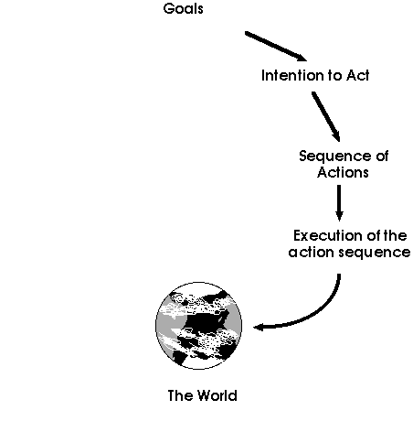
3.3.2 Gulfs of execution and evaluation
Seven stages of an activity 行動有七個階段，一個屬於目標，三個屬於執行，另外三個屬於評鑑。
Goal 形成目標
Intention 形成意願
Specify action sequence 指定行動
Execute action 執行行動
Perceive state 觀察外界狀況
Interpret state 詮釋外界狀況
Evaluate state 評鑑結果
完成一件事的四個步驟
目標
對外界做了甚麼
外界本身的變化
查看結果

Slide 26
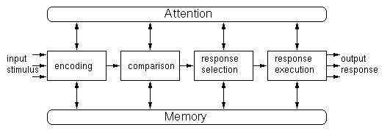
3.3.3 Information processing
Information is thought to enter and exit the mind through a series of ordered processing stages.
IPM provides a basis from which to make predictions about human performance

Slide 27
資訊處理模式有其限制
Situated cognition posits that knowing is inseparable from doing by arguing that all knowledge is situated in activity bound to social, cultural and physical contexts (Greeno & Moore, 1993).
研究開始導向 Study cognitive activities in the context in which they occur, analyzing cognition as it happens in the wild
Goal: look at how structure in the environment can both aid human cognition and reduce cognitive load.
Three approaches:
  Distributed cognition
  External cognition
  Embodied cognition

Slide 28
3.3.4 散佈式認知Distributed cognition
Cognitive activities involve people interacting with external kinds of representations
We create external representations to
  help reduce memory load
  extend what we can do and allow us to think more powerfully
The distributed cognition approach studies the nature of cognitive phenomena across individuals, artifacts, and internal and external representation.

Slide 29
It involves describing –
  A cognitive system, which entail interaction among
  People,
  the artifacts they used,
  and the Environment they are working in
How information is represented and re-presented as it moves across individuals and through the array of artifacts that are used

Slide 30
3.3.5 外部認知 External cognition
利用外在的工具來輔助人類認知
用來解釋當我們與外在物件互動時的認知過程 Concerned with explaining the cognitive processes involved when we interact with different external representations. (e.g. maps, notes, diagrams)
分為三類
  外部化以減少記憶負擔 Externalizing to reduce memory load
  減輕運算負擔 Computational offloading
  註記與認知追蹤 Annotation and cognitive tracing

Slide 31

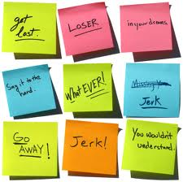
1. 外部化以減少記憶負擔
Diaries, reminders, calendars, notes, shopping lists, to-do lists - written to remind us of what to do
Post-its, piles, marked emails - where placed indicates priority of what to do (進行研究時利用post-it note)
External representations:
  Remind us that we need to do something (e.g. to buy something for mother’s day) 需要做
  Remind us of what to do (e.g. buy a card) 做甚麼
  Remind us when to do something (e.g. send a card by a certain date) 何時做

Slide 32
2. 減輕運算負擔 Computational offloading
利用工具與外部事物結合，以協助計算 When a tool is used in conjunction with an external representation to carry out a computation (e.g. pen and paper)
Exercise: Try doing the two sums below (a) in your head, (b) on a piece of paper and c) with a calculator.
Which is easiest and why? Both are identical sums

Slide 33
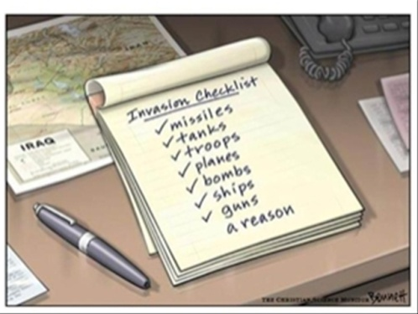


3. 註記與認知追蹤 Annotation and cognitive tracing
Annotation involves modifying existing representations through making marks
  e.g. crossing off, ticking, underlining
將物件重新安排成不同順序 Cognitive tracing involves externally manipulating items into different orders or structures
  e.g. playing cards

Slide 34
The user is tracked with GPS.
A behaviour-learning agent determines the salient locations in the user's life.
Messages or reminders can be sent to these prominent virtual locations. For example, "home", "work", "grocery store", "Grandma's".
The user will only receive the specific message when in the relevant context (physical location, time and date).
Once the behaviour-learning agent has established virtual locations and mobility patterns, it can start pushing information to the user, such as, the latest traffic report when leaving "home" on the way to "work". Or on a Friday evening after leaving "work", the agent might get the movies playing at the local cinema.

Slide 35
3.3.6 Embodied interaction
Criticism: 忽視 the way that people get thing done in real situation.
People experience the world through physical interaction
Focus on:
  Practical engagement in real social and physical context
  The Meaning is ascribed in interaction
Embodied interaction
  Emotional quality of interaction with tech.
  Actions in physically shared spaces
  How to apply a new generation of cognitive theory in interaction design

